Slide 1
Driving Towards a Better Future : Predicting anticipated traffic delays from immediately known variables
Mikhail Hershfeld – Spring 2020

Slide 2
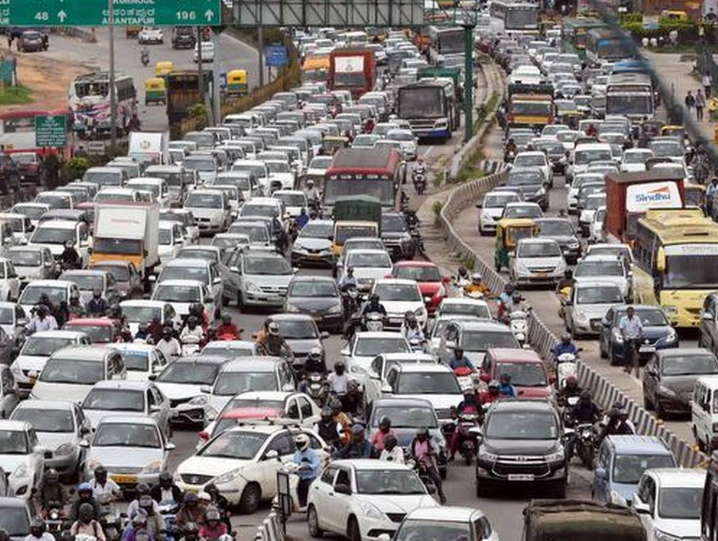
The Problem
Americans spent an average of 54 extra hours a year stuck in congested traffic (Willingham, 2019).
Not hours in traffic… extra hours on top of normal time from slower than usual traffic.
Accidents are a huge source of this congestion.
Current GPS software uses movement from cell phone data to track delays.
Only identifies accident delays after the fact.

Slide 3
My Approach
Use ~3 million accident records from 2016-2019 to predict an anticipated delay.
“Severity” in the data is used in terms of delays caused, ranges from 1-4.
Only use variables that would be immediately known from a first report.
Hypothetical use case of a GPS software being able to immediately warn motorists.
Data was sourced from Mapquest and Bing APIs.
Specifically chosen for this reason.

Slide 4
Goals
Accurately classify severity, emphasis on larger delays without sacrificing other classes.
Investigate any geographic anomalies found.

Slide 5
Challenges
Data is highly imbalanced. 99.6% of accidents are level 2 or 3.
No clear criteria from source or publisher of data why, or how exactly severity is calculated.
Limited number of features than can be used.
Large volume of data difficult to handle on my local environment

Slide 6
Methodology
Choosing to stick with the data given the context of a use case.
Dropping all level 1 accidents and keeping level 4 for final modeling.
Going with a multiclassification random forest model.
RF is versatile, familiar to me, and previous research indicates their effectiveness.

Slide 7
Previous approaches
Both Jianfeng, Hongyu, Jian, Liu & Haizhu (2019) and Garrido, Bastos, Almeida, & Elvas (2014) conducted very similar studies.
Severity was measured in terms of vehicle damage/mortality
Several useful takeaways still
Importance of careful feature selection
Location and road data has most informative power
Tree based modeling works well.

Slide 8
Geographic Anomalies
West Virginia and Arkansas were found to have a disproportionate amount of severe accidents, with a statistically significant sample size.
Data on why this was the case was limited, and qualitative sources had to be used.
Much more available for ARK than WV.
To summarize-
ARK has high traffic volume, high freight volume, narrow, poorly maintained highways.
Ozark national forest.
Can be hypothesized these cause more severe accidents.

Slide 9
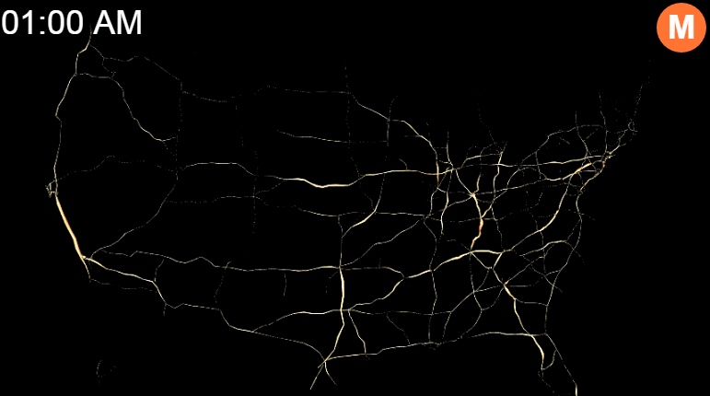
Daily U.S. Traffic Volume
Source: Max Galka, Metrocosm, 2016

Slide 10
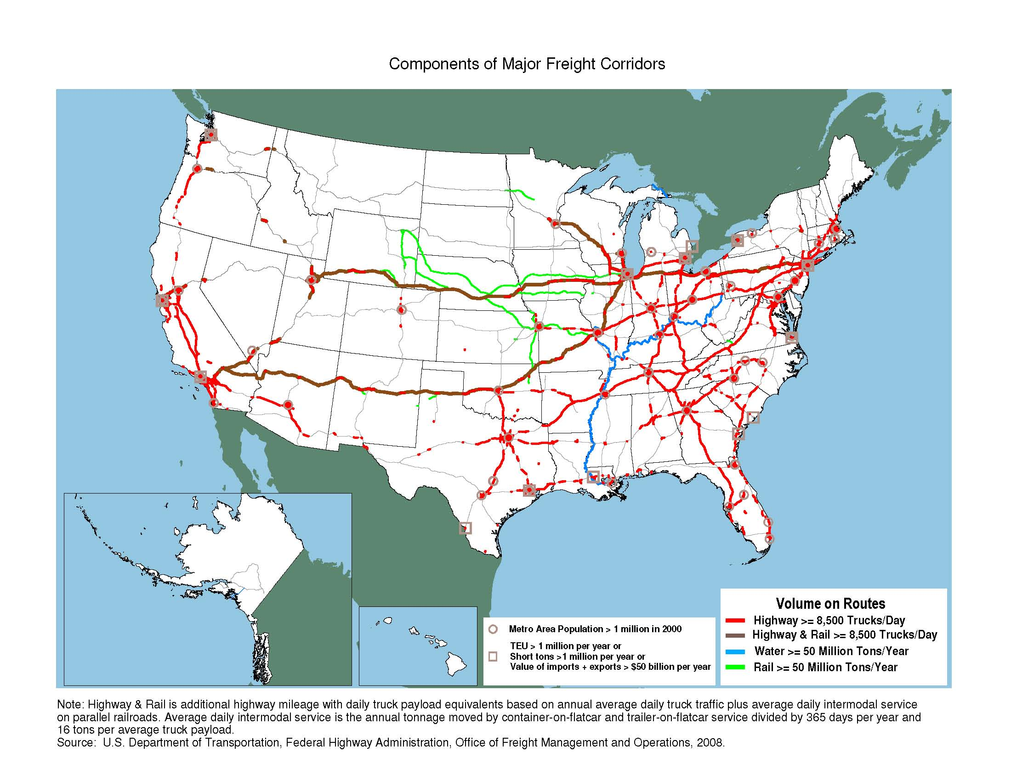

Slide 11
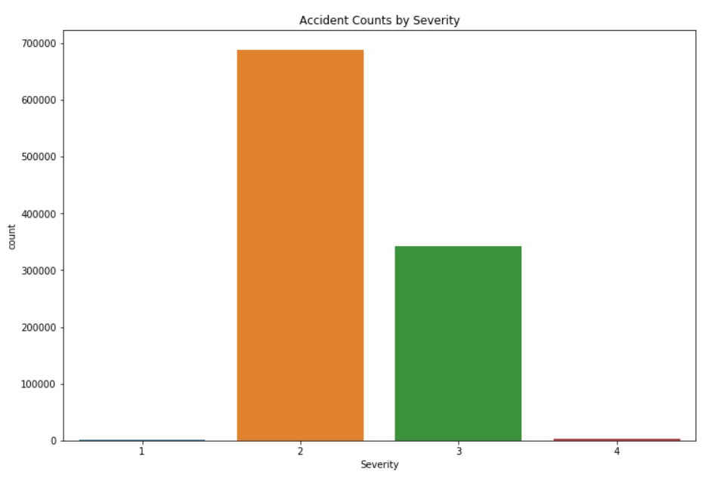
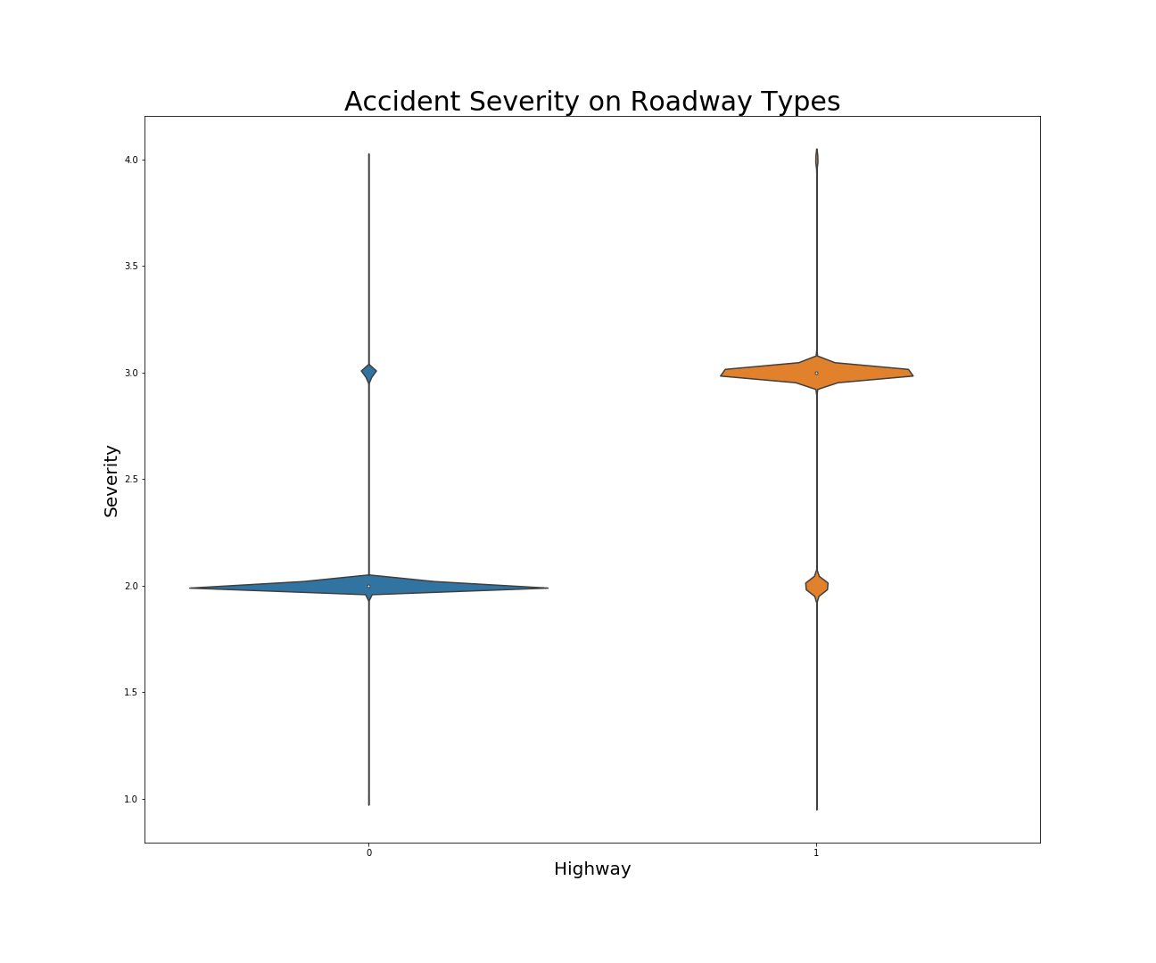
EDA
Severe data imbalance can be seen
Whether it occurred on an interstate highway was the most obvious trend.

Slide 12
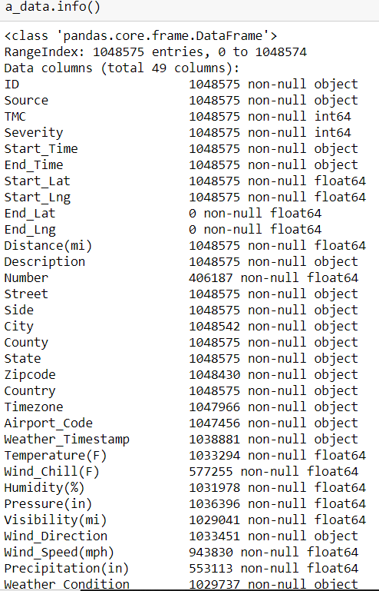
EDA
Sampled a portion the dataset due to computing resources
Lots of missing values for important features, namely weather.
Filled in missing values where possible, interpolated weather data

Slide 13
Modeling
First removed features only relevant for geographic identification.
Added in several more for road type
More features from information in accident description:
Multi-Vehicle collision
Relatively serious collision
Oil/Fuel Spillage
In a construction zone
Road immediately blocked
Jacknifed trailer
Ramp immediately blocked

Slide 14
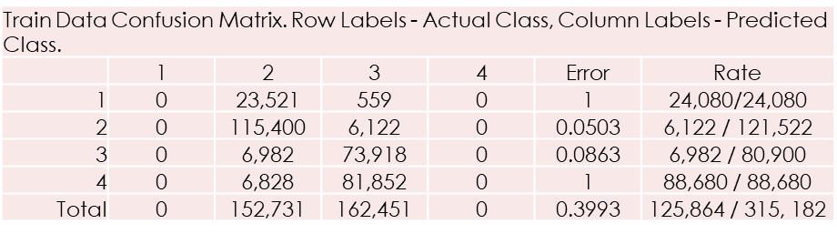
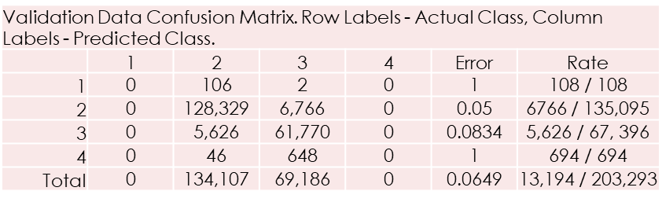
Modeling
Results from first baseline run (RF with default hyperparameters):
Robust in classifiying 2 and 3, but even with oversampling 1 and 4 are ignored

Slide 15
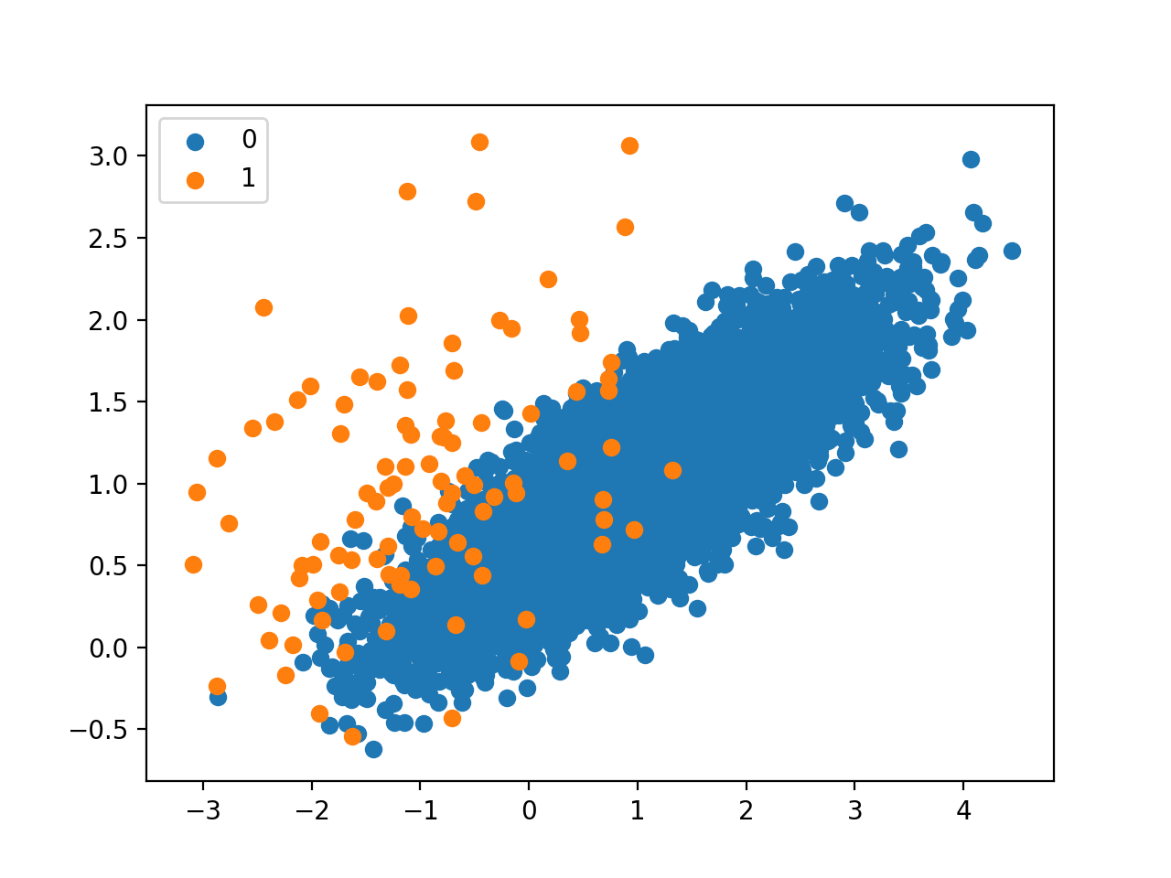
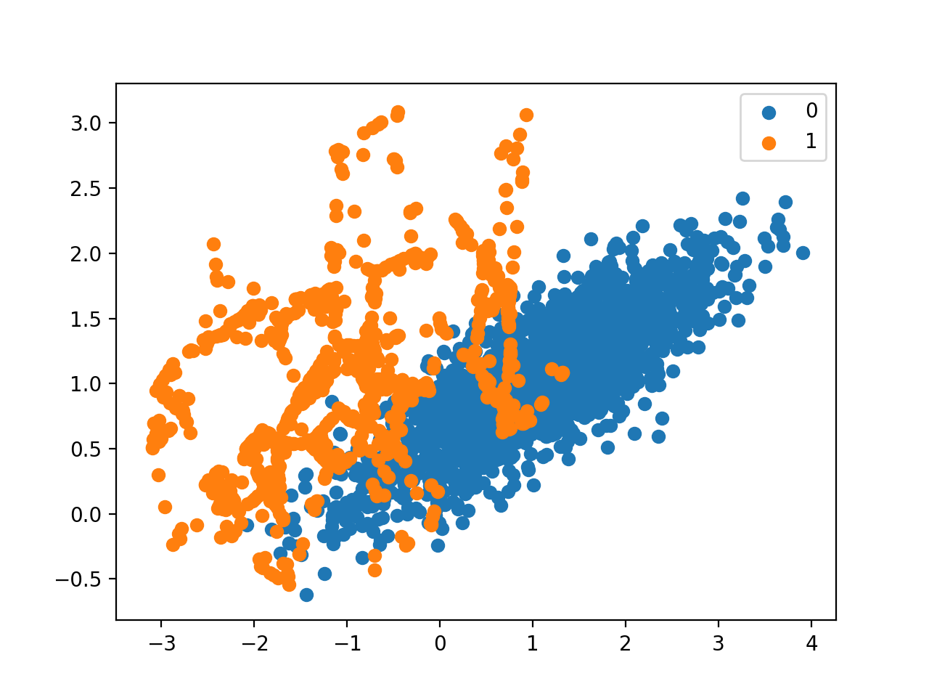

Modeling
Only model selection and tuning would not be enough to achieve acceptable results.
Instead of oversampling, tried using SMOTE (synthetic minority oversampling technique).
SMOTE finds K-NN of minority class points and generates new points in Euclidean space between them.
Source: Brownlee, MachineLearningMastery, 2019

Slide 16
Modeling with SMOTE
53.3% accuracy of severe accidents rather than 0%.
Trade off for 18% accuracy drop for level 2.
1 still being ignored, chose here to drop it.
Train Data Confusion Matrix. Row Labels - Actual Class, Column Labels - Predicted Class.
 | 1 | 2 | 3 | 4 | Error | Rate
1 | 220,600 | 27,142 | 772 | 1,486 | 0.1176 | 29,400 / 250,000
2 | 9,041 | 388,274 | 16,888 | 5,797 | 0.0755 | 31,726 / 420,000
3 | 1,197 | 17,442 | 281,900 | 99,461 | 0.2952 | 118,100 / 400,000
4 | 548 | 822 | 39,416 | 359,214 | 0.1019 | 40,786 / 400,000
Total | 231,386 | 433,680 | 338,976 | 465,958 | 0.1496 | 220,012 / 1,470,000
Validation Data Confusion Matrix. Row Labels - Actual Class, Column Labels - Predicted Class.
 | 1 | 2 | 3 | 4 | Error | Rate
1 | 9 | 186 | 5 | 0 | 0.9555 | 191 / 200
2 | 1,729 | 253,704 | 10,817 | 3,760 | 0.0603 | 16,306 / 270,010
3 | 76 | 10,763 | 99,766 | 24,351 | 0.2607 | 35,190 / 134,956
4 | 0 | 91 | 574 | 759 | 0.4669 | 665 / 1,424
Total | 1,814 | 264,744 | 111,162 | 28,870 | 0.1287 | 52,352 / 406,590

Slide 17
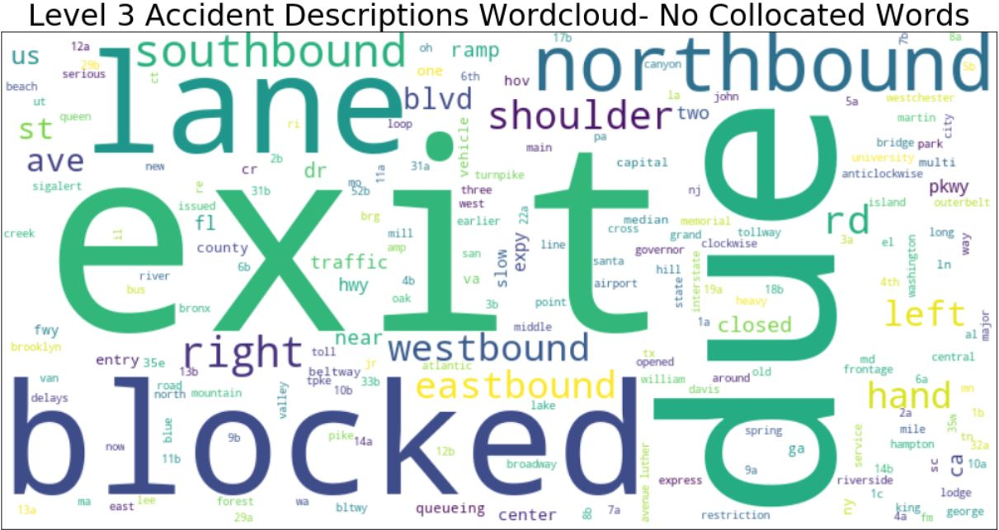
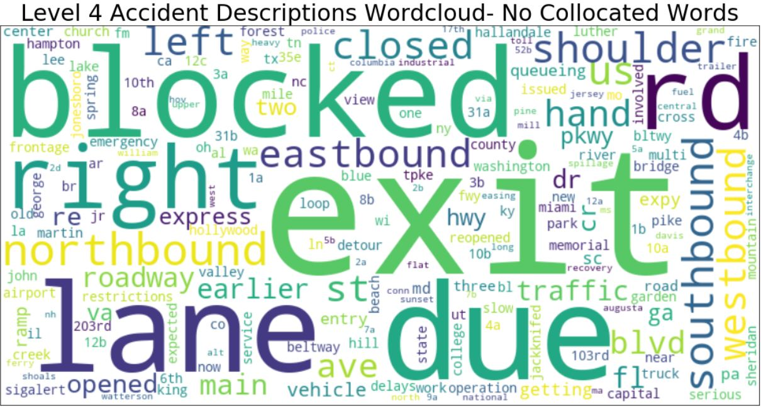
Model Improvements
Conducted text analysis to add features differentiating the classes.
Based on text data, added features for:
An earlier accident
Re-opened road
Immediate detour
Emergency vehicles called
Near ramp or exit

Slide 18
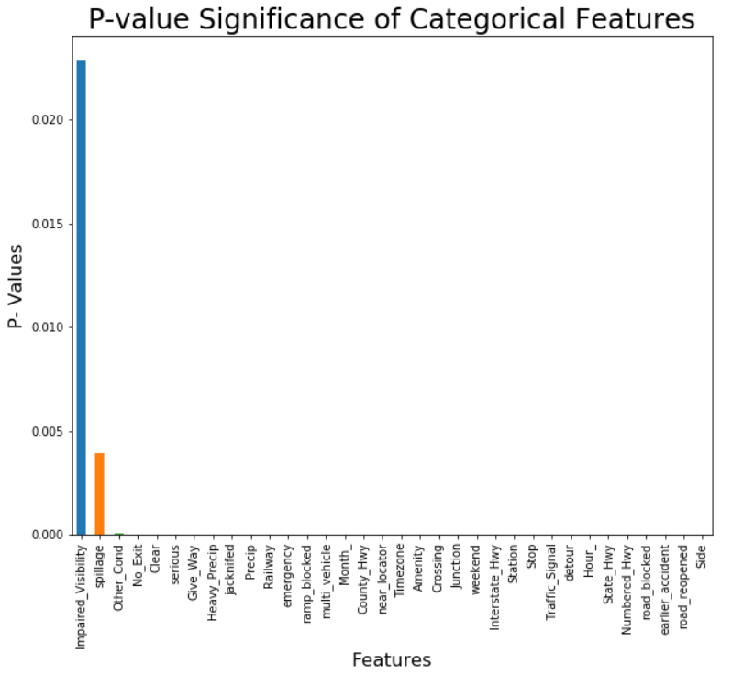
Model Improvements
Used GIS tools to add in population density
Chi-squared testing to locate relevant features.

Slide 19
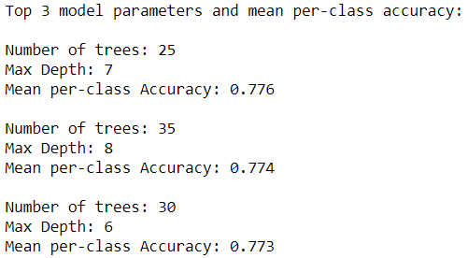
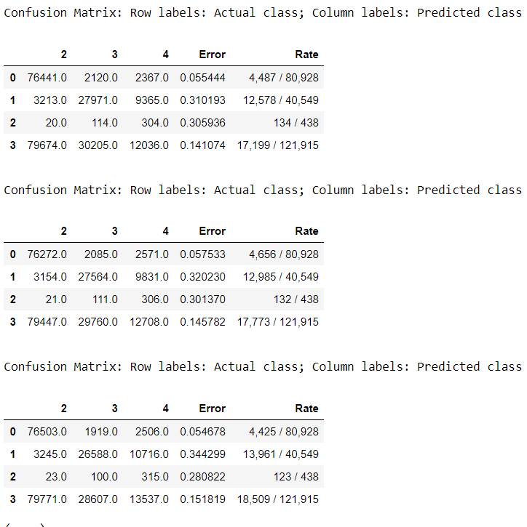
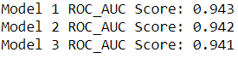
Modeling
Confusion Matrices for Top 3 Models
Utilized grid search to find optimum hyperparameters.
Measured by macro-averaged recall to give equal weight to minority classes. (Same as mean per-class accuracy) accuracy).

Slide 20
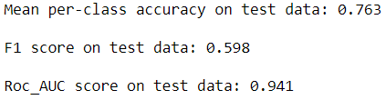
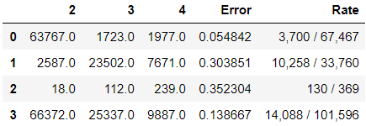
Results
Performance on holdout test data is consistent.
Decent results and significantly better than before, but not ideal.
SMOTE causes a vast amount of extra 4 classifications
Improved accuracy, but very imprecise. Plus at cost of level 3 accuracy.
Level 2 stays robust.
High ROC_AUC score buoyed by strong level 2 metrics.
Low F1 score indicative of very low precision for level 4.

Slide 21
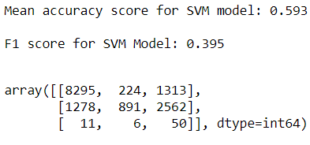
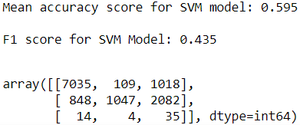
SVM Modeling
Validation Data
Test Data
Tested out a one vs. rest penalized SVM model due to their strengths in handling imbalanced data.
Results were poor, random forest is clearly superior in this scenario

Slide 22
Conclusions
Immediately predicting accident severity is a very accomplishable task.
Baseline >90% accuracy for 2 and 3 early and smattering of other positive metrics show this.
Questions lie mainly with the data and available features.
Data source was chosen because the context makes sense, but questions abound.
Modeling and toolkit I established have the ability to work, but hit a ceiling in this scenario.
In context, modeling could function as a warning system.
Predicted class of 4 would mean likely moderate delay, with a chance of a severe one.
This type of behavior would work decently well in practice.

Slide 23
References
Brownlee, J. (2020, April 7). SMOTE for Imbalanced Classification with Python. Machine Learning Mastery. Retrieved from https://machinelearningmastery.com/smote-oversampling-for-imbalanced-classification/
Components of Major Freight Corridors Map. (2008). US Department of Transportation, Federal Highway Administration, Office of Freight Management and Operations. Retrieved from https://ops.fhwa.dot.gov/freight/freight_analysis/nat_freight_stats/compofmajorfghtcorr.htm
Galka, M. (2016, September 26). Watch 24 Hours of Traffic, Visualized as a Living Circulatory System. Metrocosm. Retrieved from http://metrocosm.com/map-us-traffic/
Garrido, R., Bastos, A., Almeida, A. D., & Elvas, J. P. (2014). “Prediction of Road Accident Severity Using the Ordered Probit Model”. Transportation Research Procedia, 3, 214–223. doi: 10.1016/j.trpro.2014.10.107
Jianfeng, X., Hongyu, G., Jian, T., Liu, L., & Haizhu, L. (2019). “A classification and recognition model for the severity of road traffic accidents”. Advances in Mechanical Engineering, 11(5), 1687814019851893
Willingham, A. J. (2019, August 22). Commuters waste an average of 54 hours a year stalled in traffic, study says. CNN. Retrieved from https://www.cnn.com/2019/08/22/us/traffic-commute-gridlock-transportation-study-trnd/index.html

